Slide 1
Luminosity – Energy Output of the Star
Understanding the concepts

Slide 2
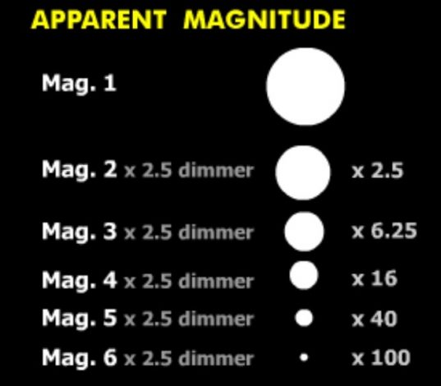
Apparent magnitude
Apparent magnitude (^{m}) is a measure of the brightness of a star or other astronomical object observed from the Earth. The magnitude scale is reverse, the brighter an object is, the lower its magnitude. For example, a star of magnitude 1^{m} is brighter than a star of magnitude 2^{m}. The brightest stars have apparent magnitudes of about 0^{m}. The faintest stars visible with the naked eye have apparent magnitudes of about +6^{m}. Can you see the star of the magnitude 8^{m} with the naked eye?
Credit: GCSEastronomy

Slide 3
1
2
3
Distance is important!
By knowing the apparent magnitude alone you cannot determinate the luminosity of the star (real energy output) because the distances to the stars are different. Nearby star Sirius (distance 9 light years) looks brighter than the far away star Deneb (distance 2600 light years).
Picture not to scale!
6
7
Public domain image

Slide 4
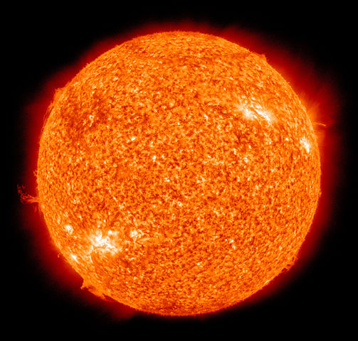
What is luminosity?
Luminosity is the total amount of electromagnetic energy emitted per unit of time by a star, galaxy, or other astronomical object. Luminosity is measured in watts. In astronomy, values for luminosity are often given in the terms of the luminosity of the Sun, solar units. Luminosity of the Sun (pictured) is 3,8×10²⁶ W.
Luminosity of Peony star is about 3 200 000 solar units!
Public domain image

Slide 5
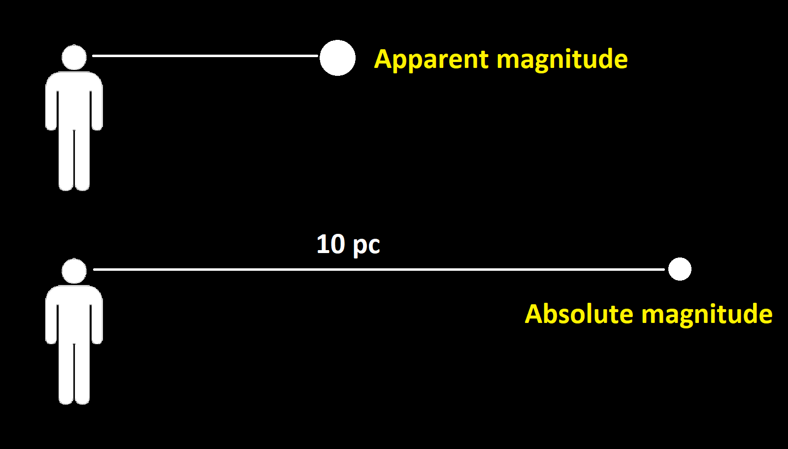
Absolute magnitude
Astronomers also use the absolute magnitude to measure the intrinsic luminosity of a celestial object. Absolute magnitude is defined as the apparent magnitude that a star or object would have if it were observed from a distance of 10 parsecs. The parsec (pc) is a unit of length used to measure the large distances to astronomical objects. One parsec is approximately equal to 31 trillion kilometres. Absolute magnitude of the Sun is +4,8. Could you see the Sun with the naked eye at 10 pc?
Public domain image

Slide 6
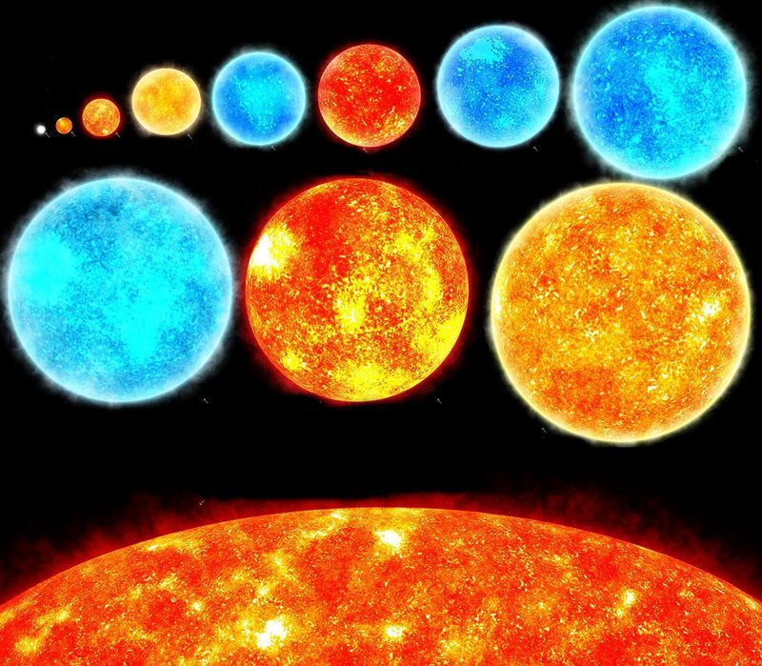
Luminosity classes
Stars are divided in different luminosity classes: 0 (hypergiants), I (supergiants), II (bright giants), III (giants), IV (subgiants) and V (main sequence dwarfs). Sometimes classes VI (subdwarfs) and VII (white dwarfs) are used as well. Hypergiants have the highest luminosity, white dwarfs – the lowest. How do you think? Show on the picture which star belong to which luminosity class!
Credit: Karl Garnham CC BY-SA 3.0

Slide 7
Assessment
Why it is not possible to determinate the luminosity of the star from its apparent magnitude alone?
Because the distance is not known
2. Spectral designation of the Sun is G5V. To which luminosity class it belongs?
Main sequence dwarfs
3. Deneb is a white supergiant of spectral class A2. What is the spectral designation of the star? Use the Roman numeral of luminosity class!
A2I

